Slide 1




INFO 6101 is a prequel to INFO 6105 is a prequel to INFO 7390
INFO 6101 :Data Science Engineering with Python
Source: medium.com, numpy, scikit-learn,

Slide 2
INFO 6101 has
TWO TRACKS
We want to include everyone, both beginners &
students looking to learn numerical python
First 60 mins of each lecture covers Python &
Programming basics
Last 30 mins will cover numerical computation
using Python

Slide 3
Course structure
Course has 12 modules, one module per week, one week break
Videos = humor + new concepts
Data for the notebooks
Contents of a typical module
(Python code, math, & intuition)
Python code inside of Jupyter notebooks
Slides used in the lectures
Email me with questions
Links to more resources on the web
Test your understanding questions
(Self-evaluation)
Forum interactive feedback/slack

Slide 4


Course Grading
Descriptive/Objective questions
Coding questions
Sent 4rd and 8th week, deadline 2 weeks
Assignments are different for the two tracks
Two assignments
(40%)
Final grade =
+
One final project
(60%)
One final project beginning at week 1
Writing a whole machine learning algorithm from scratch
Individual OR group projects are OK ! You can form groups yourself or we can help !

Slide 5
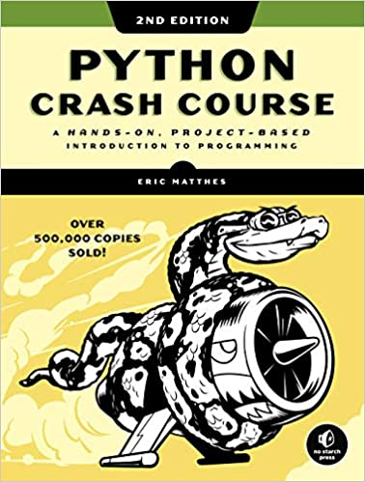
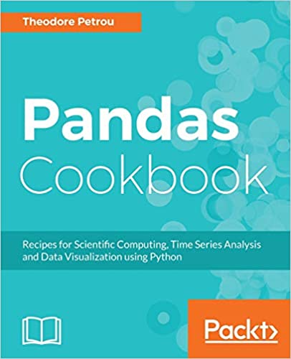

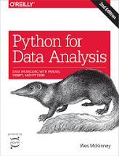

Textbooks for the course
Source: University of Wisconsin

Slide 6

It’s time to discuss…welcome explorers and adventurers…

